Slide 1
Setup QA Process
Software Quality Assurance
Telerik Software Academy
http://academy.telerik.com

Slide 2
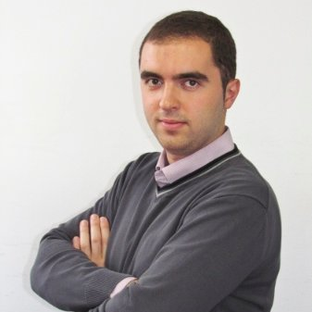
The Lectors
Angel Tsvetkov
QA Architect
DevCloud Core Team
Email: Angel.Tsvetkov@telerik.com
Blog: http://theqaangel.wordpress.com/

Slide 3

THE TEAM
QA
DEV

Slide 4

THE PROJECT
WEB

Slide 5
THE ITERATION
2 WEEKS

Slide 6
Agenda
Build Solid Ground
Test In Agile Environment
Test Infrastructure
Continuous Delivery

Slide 7

Build Solid Ground
In-Team Communication

Slide 8
Build Solid Ground (1)
Do We Need Separate Test Process?

Slide 9
Test In Agile Environment
Everybody Testing
Definition Of Done
React On Quick Changes

Slide 10
Test In Agile Environment (1)
Performance Testing
UI Testing
Unit Testing
Acceptance Testing
Service Testing

Slide 11
Test In Agile Environment (2)
Not Done
In Progress
Ready For Test
Done
Not Done
In Development
Developed
Ready For Test
Done
In Testing

Slide 12
Test Infrastructure
Scalability
Execution Mechanism
Topology

Slide 13

Test Infrastructure (1)
Diagnostic Tests Runner
Service Tests Runner
Performance Tests Runner
UI Tests Runner

Slide 14
Test Infrastructure (2)
DEMO

Slide 15
Continuous Delivery
TEST
TEST
TEST
Development
Integration
Test
Live

Slide 16



Continuous Delivery (1)
11.6 sec
10-12 h
2-3 days

Slide 17
Continuous Delivery (2)
30 times more often releases
8000 times faster deployment
50% fewer failed deployments
restore service 12 times faster

Slide 18
Setup QA Process
?
?
?
?
?
Questions?
?
?
?
?
?
?

Slide 19




Free Trainings @ Telerik Academy
C# Programming @ Telerik Academy
csharpfundamentals.telerik.com
Telerik Software Academy
academy.telerik.com
Telerik Academy @ Facebook
facebook.com/TelerikAcademy
Telerik Software Academy Forums
forums.academy.telerik.com

